Slide 1
Tableau Project
Housing Price Analysis

Slide 2
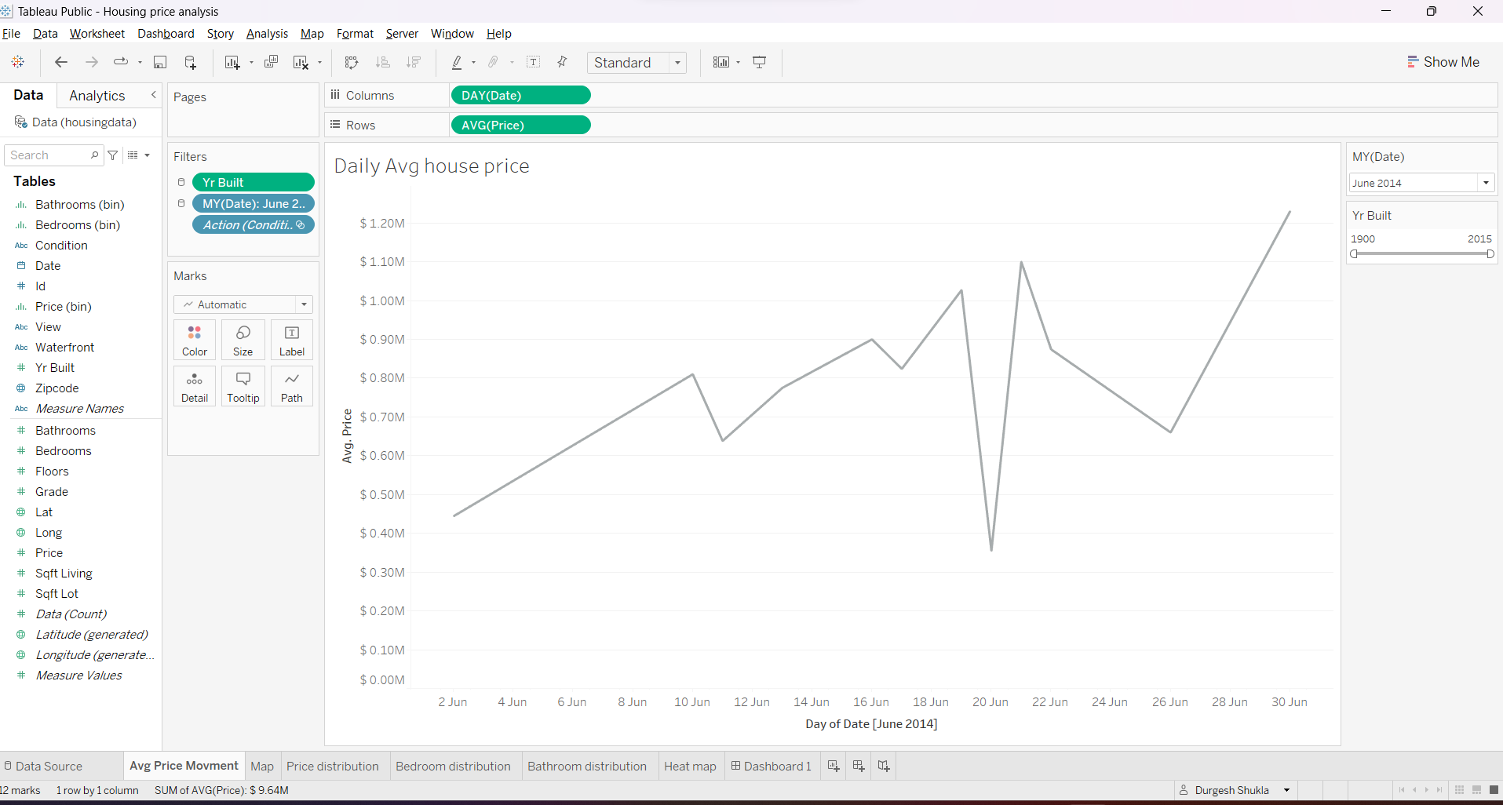
Daily Average House Price

Slide 3
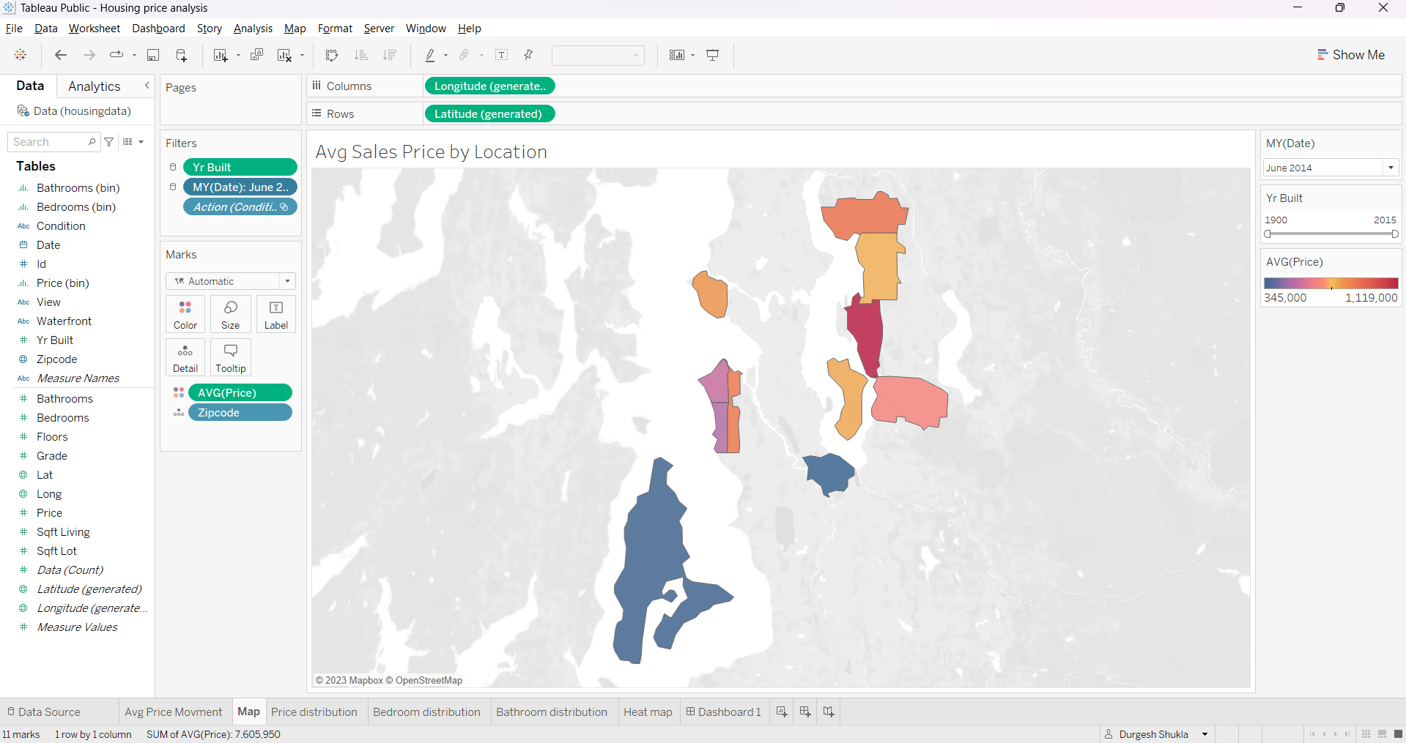
Average Sales Price as per Location

Slide 4
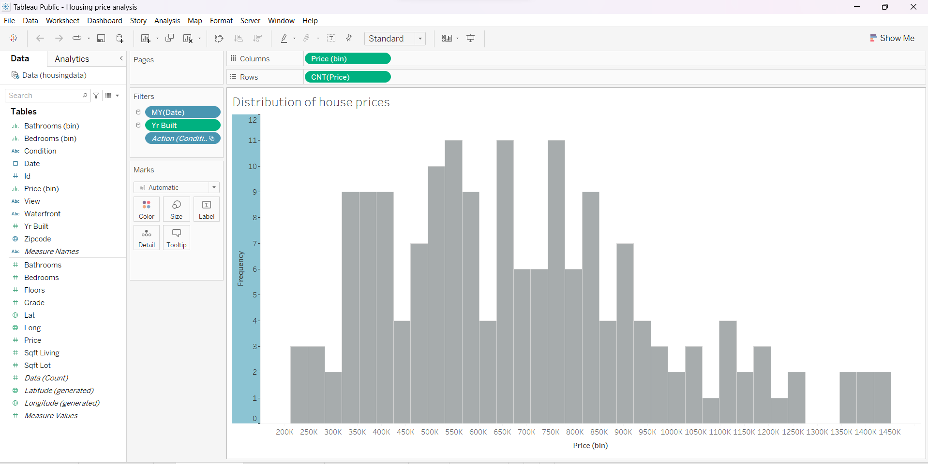
Price distribution

Slide 5
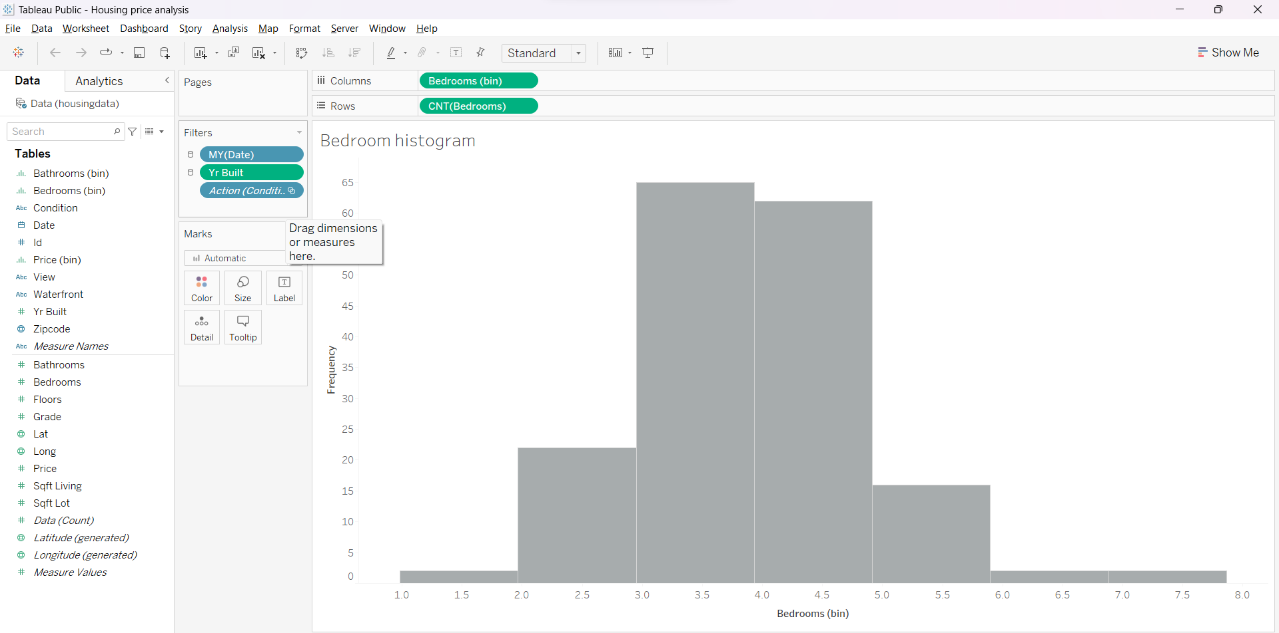
Bedroom Distribution

Slide 6
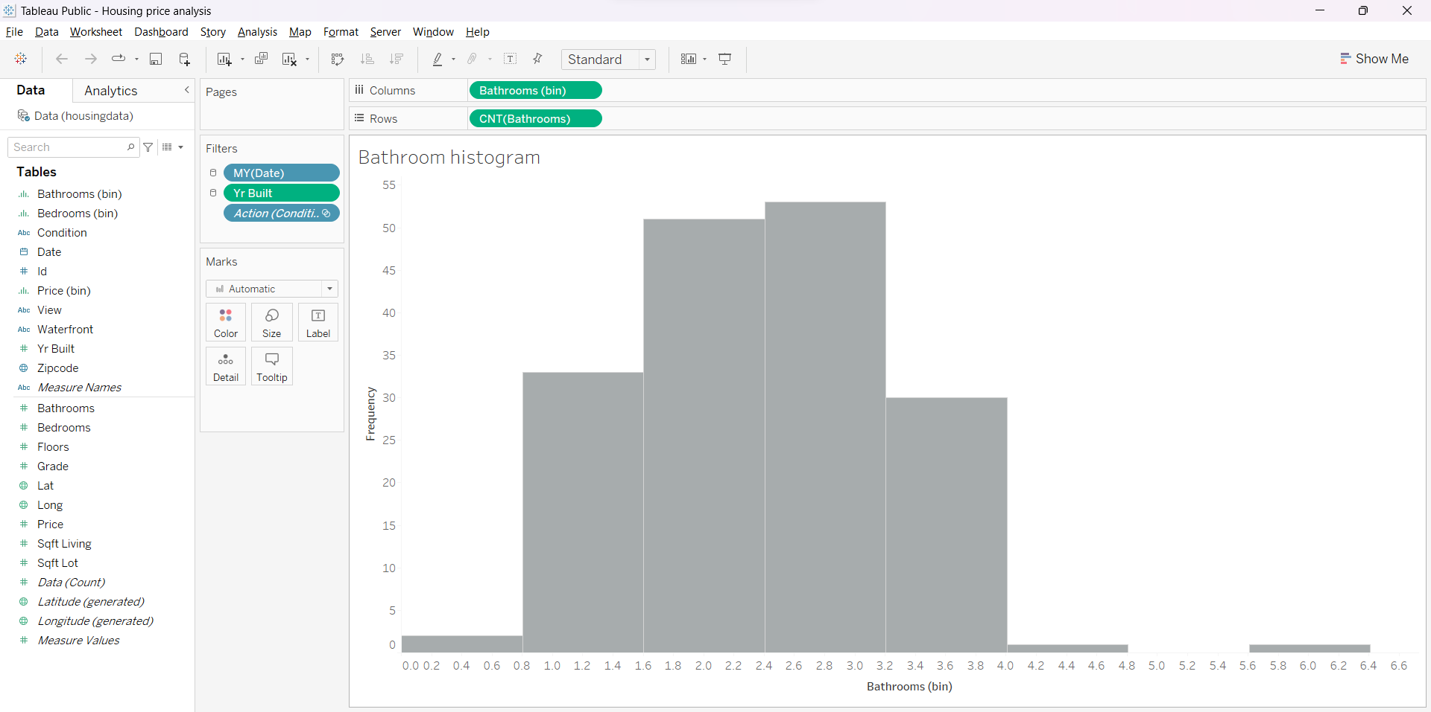
Bathroom distribution

Slide 7
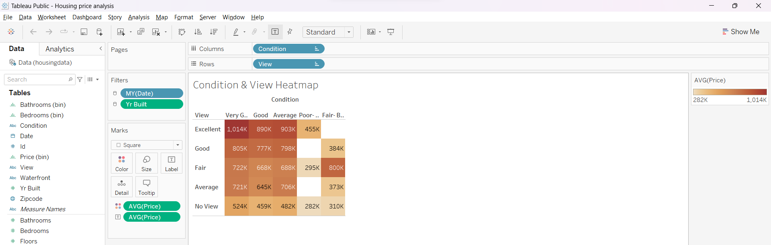
Heatmap

